Slide 1
Dimensionality Reduction

Slide 2
The Curse of Dimensionality
As the number of dimensions increases, the volume of the unit hypersphere does not increase with it.
Our algorithms try to separate data into classes based on the features; therefore as the number of features increases, so will the number of datapoints we need.
V_{n} = (2𝛑/n)v_{n−2}, n > 2𝛑 , the volume starts to shrink.

Slide 3
Dimensionality Reduction approaches
Feature selection: looking through the features and seeing whether or not they are actually useful, i.e., correlated to the output variables.
Feature derivation: deriving new features from the old ones, generally by applying transforms to the dataset by moving and rotating them, which can be written simply as a matrix applied to the data
Clustering: grouping together similar data points, and to see whether this allows fewer features to be used.

Slide 4
Linear Discriminant Analysis (LDA)
The covariance matrix can tell us about the amount of spread within the data.
For labelled input data:
within-class scatter
between-class scatter
S_{B}/S_{W} as large as possible

Slide 5
Projection Lines
Given a line w, The projection of the data can be written as z = w^{T} · x for data point x.
Goal: find a projection w maximizing the ratio of

Slide 6
Transformation of Coordinate Axes
Designed for unlabeled data (no class needed)
Goal: finding particular sets of coordinate axes, to show that some of the dimensions are not required

Slide 7
How to choose the axes? Principal Component Analysis (PCA)
Input: a data matrix X; Output: to rotate it so that the data lies along the directions of maximum variation
i.e., to choose a rotation matrix P^{T} (P^{T} = P⁻¹) s. t. Y = P^{T}X, the covariance matrix of Y is diagonal:
eigenvector equation
eigenvalues
eigenvectors
All eigenvectors of a square symmetric matrix A are orthogonal to each other; the eigenvectors define a space (eigenspace). The eigenvalues represent the variation along each eigenvector dimension.

Slide 8
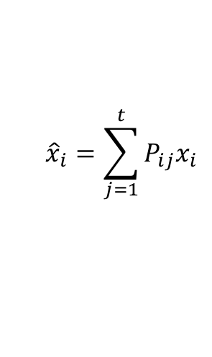
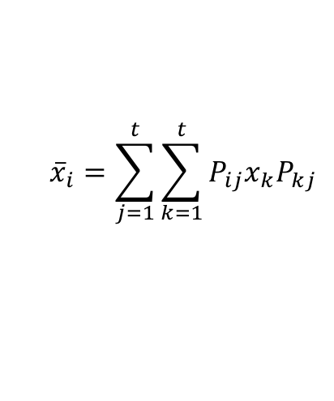
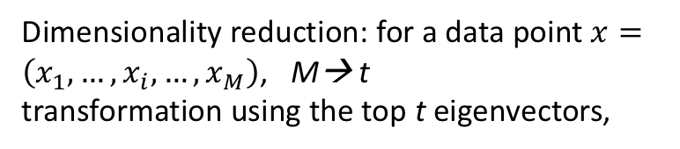
Dimensionality reduction: for a data point $x=\left(x_{1},…,x_{i},…,x_{M}\right)$, M→ t
transformation using the top t eigenvectors,
$${\hat{x}}_{i}=\sum_{j=1}^{t}{P_{ij}x_{i}}$$
$${\overline{x}}_{i}=\sum_{j=1}^{t}{\sum_{k=1}^{t}{P_{ij}x_{k}P_{kj}}}$$
reconstruction

Slide 9
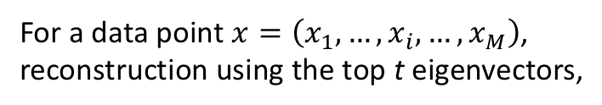
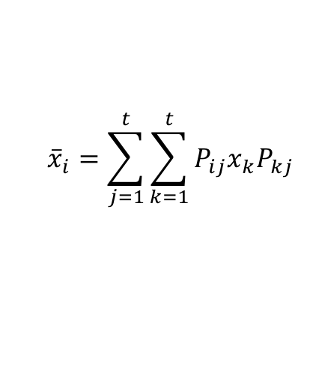
For a data point $x=\left(x_{1},…,x_{i},…,x_{M}\right)$,
reconstruction using the top t eigenvectors,
$${\overline{x}}_{i}=\sum_{j=1}^{t}{\sum_{k=1}^{t}{P_{ij}x_{k}P_{kj}}}$$
t=1

Slide 10
Kernel PCA
The covariance matrix is defined in the kernel space
N is the number of data points in the set
are the eigenvectors of the original problem
an N * N kernel matrix K
eigenvector equation
Computing the projection of a new point x into the kernel PCA space requires:

Slide 11
Projections

Slide 12
Factor Analysis
Assumptions: variables are interrelated
100 unrelated variables → 100 factors
Data matrix must have sufficient number of correlations and some underlying factor structure
The data points are homogeneous; the factors are orthogonal; both in M dimensions cov(b_{i}, b_{j}) = 0
Do not assume data distribution.
error: Gaussian with 0 mean and variance 𝜳, same for all data
Data: N*M
Factor loading: N*t matrix
cov(Wb+𝝐) = WW^{T}+𝜳
Factors: t*M matrix (t <N)

Slide 13
Locally Linear Embedding (Roweis & Saul, 2000)
Linear embedding: using all other datapoints to reconstruct each datapoint
Key idea: minimizing the errors of linear approximations by using small patches (neighborhood) in which the linearity is good even through globally there are lots of non-linearity in the data
Define neighborhoods
Points that are less than a distance threshold d to the current point are neighbor
The k nearest points are neighbors
Set W_{ij}=0 iff points i and j are neighbors, and normalize

Slide 14
LLE
Dimensionality reduction: mapping to embedded (lower) L dimension space
𝝐

Slide 15
Multi-Dimensional Scaling (MDS)
Key idea: to find a linear approximation that embeds the data into a lower dimensionality and preserve the distances between all pairs of datapoints
Cost functions
Gradient descent can be used to minimize the distances

Slide 16
Isomap algorithm works on datapoints in non-flat space. It assumes that the distances between pairs of close points (neighbors) are good, since over a small distance the non-linearity of the manifold can be ignored. It builds up the distances between points that are far away by finding paths that run through points that are close together, i.e., that are neighbors, and then uses MDS on this distance matrix

